Slide 1
Small Parts Inventory
NXT

Slide 2
BRICKS
1 of each color (red, green, yellow)
(8) 1 x 2
(2) 1 x 2 with axle hole
(4) 2 x 2

Slide 3
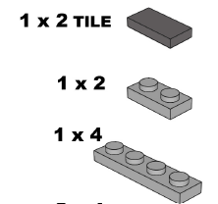
PLATES and STUDDED BEAMS
(2) 1 x 2 tile
(4) 1 x 2
(4) 1 x 4
(4) 1 x 2 with one hole

Slide 4
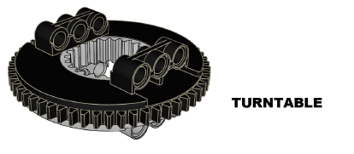
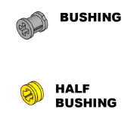
GEARS
(1) turntable
(10) gray bushings
(10) Yellow half bushings

Slide 5
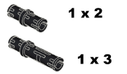
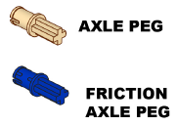
PEGS and AXLES
(60) 1 x 2 black
(36) 1 x 3 blue or black
(8) tan
(10) blue
(8) 2-hole red axles

Slide 6
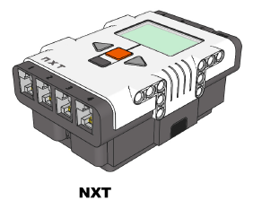
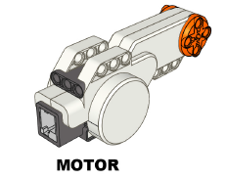
BRICK and MOTORS
(1) NXT brick
(1) battery
(3) motors

Slide 7
MINIFIG and BELTS
(1) Minifig with hat OR hair
(2) Yellow belts
(2) Red belts

Slide 8
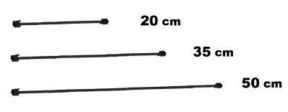
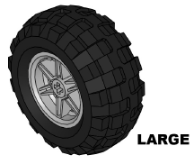
WIRES and WHEELS
(1) 20 cm
(4) 35 cm
(2) 50 cm
(1) USB cord
(4) Large wheels

